Slide 1

Strategic Insights For Contoso Sales
Addressing revenue challenges post COVID-19.

Slide 2
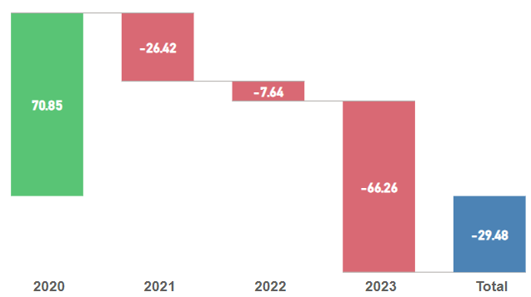

We generated a total Net Revenue of 11.5M, but it has depleted by -29.48% ever since 2019.
YoY% Change
Why is the Net Revenue depleting?
Notes:
The waterfall chart explains the change in total net revenue. In 2020, post covid - 19, the sales have increased by 70% due to shift from offices to remote work, compelling consumers to buy products required for remote work.
But, in 2021, a drop of 26.42% is observed, gradually decreasing by 7.64% in 2022 and followed by 66.26% in 2023. Due to incomplete data for 2023, the figures are not comparable. Hence, in the following analysis we will try to understand the sales performance for 2019, 2020, 2021 and 2022.
The following slides will provide deeper analysis and key findings that will fortify our understanding of depleting sales over the year.

Slide 3
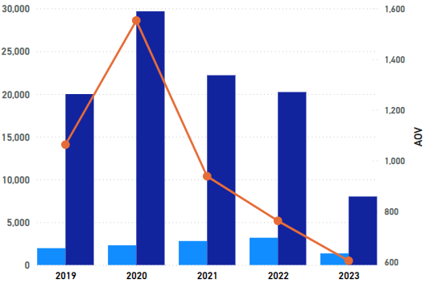



In 2020, we sold 29% of total quantity compared to 19% in 2019, 22% in 2021, 20% in 2022 & 8% in 2023.
Total Quantity, Total Orders and AOV
In 2019, we processed 1,971 orders, resulting in $2 million in revenue. In contrast, 2020 saw an increase to 2,305 orders, generating a substantial $3.57 million in revenue.
However, in 2021, despite handling 2,807 orders, revenue decreased to $2.63 million, reflecting a nearly $1 million reduction. This trend continued in 2022, where 3,191 orders yielded only $2.43 million
Quantity
Orders
AOV
Notes:
Strategic Considerations:
1) AOV: Implement strategies to increase AOV, such as upselling, bundling, or introducing premium products. This can help counteract the declining trend seen from 2020 to 2023.
2) Analyzing Purchasing Behavior: We should tailor our marketing and sales strategies in accordance with the trends as seen from 2020 till 2023. We observe that Home office has highest net revenue till 2022 (due to Covid), but we can observe gradual decline year on year, on the contrary as lock-down eased in USA work from office increased gradually which is reflected in the purchasing behavior of Corporate. In 2023 our highest revenue generating segment was corporate and by a huge margin as well.
We should opt for a balanced strategy by dividing equal resources between the corporate and the home office as home office culture will not die completely.

Slide 4
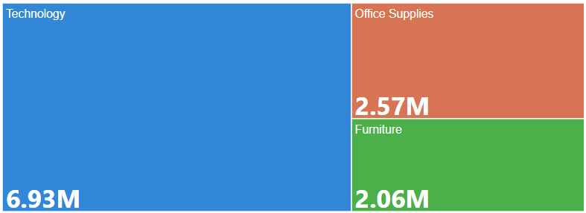
Total Revenue by Product Category
In 2019, prior to the onset of COVID-19, technology accounted for only 41% of our total revenue. However, as the pandemic forced a shift to remote work, there was a significant increase in demand for technology, which contributed to 70% of our net revenue in 2020. This trend continued in 2021, with technology contributing 69% of revenue, but declined to 60% in 2022.
A similar trend was observed in the Office Supplies and Furniture categories. Storage and chairs emerged as the highest revenue-generating sub-categories. We sold 1,373 chairs in 2020, but sales dropped sharply in the following years, with only 687 chairs sold in 2021 and 856 in 2022. The sales of storage items, however, remained stable over these years.
Notes:
Despite of very strong performance in 2020, the revenue has been depleted in 2021, 2022, 2023.
Ignoring 2023, as we don't have data for Q3 and Q4, still, the revenue has reduced by 34%.
In the following slides we'll propose reasons for the revenue depletion as well as strategic actions to increase the revenue.
Let's start by looking at what type of products are being sold. A staggering 7M of the revenue is coming from Technology alone. This is analogous with the fact that people started shifting to WFH after Covid - 19, which compelled the consumers to buy personal tech which they require to work.
In the Heat map visualization, you can see the drill-down of product subcategory.

Slide 5
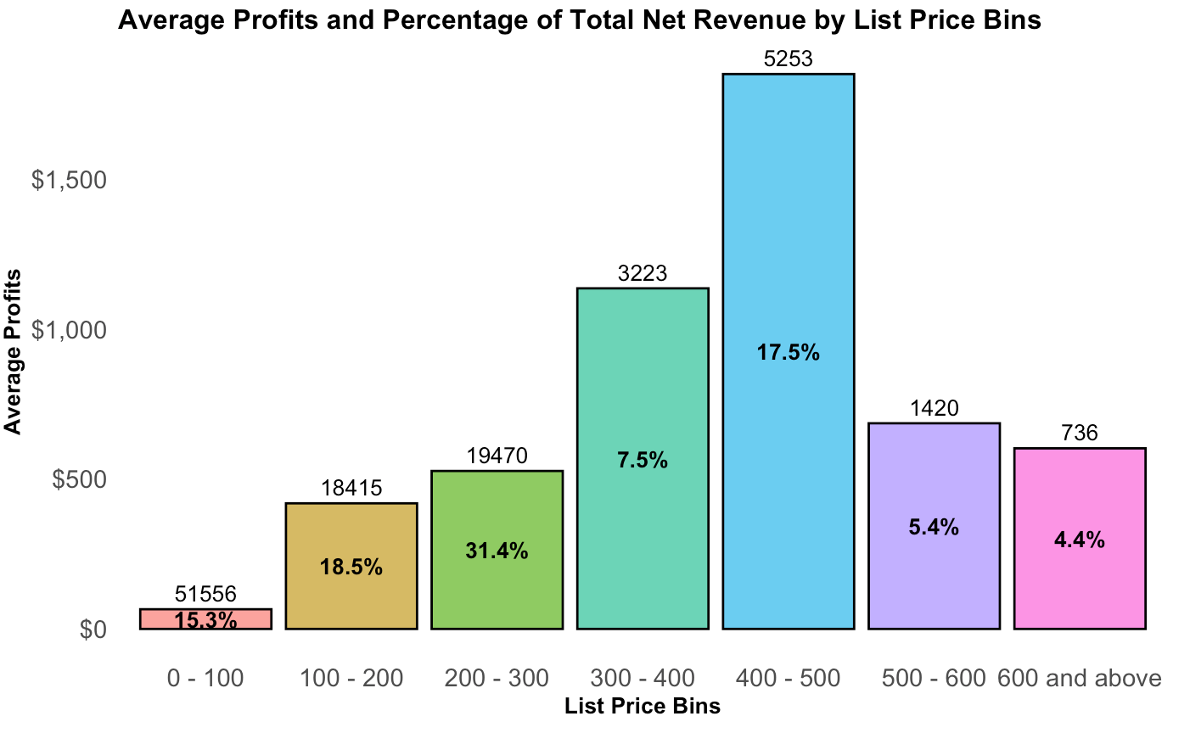
For a deeper analysis, we binned the Product List Price to understand the sales performance.
Notes:
To further understand the reasons for revenue distribution, we decided to create bins of Products List Price to understand the sales performance.
In our analysis, we found that 31% of the revenue was coming from products ranging between 200 - 300, which mainly consists of headsets, headphones, keyboard and mouse.
Understanding the product behaviour for 200 - 300 is vital as it yields the maximum profit.
The average profit are the highest for the products in the range of 400 - 500, but due to very less quantity sold, it does not contribute a lot to the total revenue. Similarly, we sold 51556 products in the range from 0 - 100, but due to less profits, it does not contribute much to the actual net revenue.
By looking at this analysis, the product range which actually affects the revenue is 200 - 300. Hence, in the next slide we'll see a deeper analysis.

Slide 6
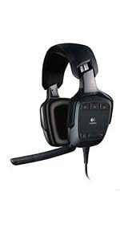
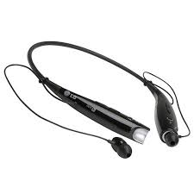

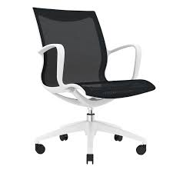
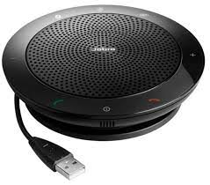
OF REVENUE COMES FROM PRODUCTS RANGING BETWEEN 200 -300.
31
%
Products in the range of 200 - 300 are criticial for the company. In 2019, it brought home 668K in revenue. But, in 2020, the sales skyrocketed bringing in 1.36M, ~40% of the total revenue. In 2021, the sales halved, earning only 627K, followed by 694K in 2022.
BABY TAYLOR FINN
Notes:
The highest selling products in the range of 200 - 300 are speakers, headphones, headsets, bookcases and chairs.
In 2020, to accommodate the need of consumers for remote work, the products were being sold in large quantities. For example - we sold 1236 products of Logitech Headsets along with 1214 products of LG Headsets. This amount of quantity is not observed in any year.
To summarise, in 2020, we sold 7305 but in 2021, we sold only 3437 products followed by 3724 products in 2022. You can observe a very huge difference which also contributes a lot towards the net revenue.

Slide 7
Top 5 Selling Products
Product Name | Cost Price | Selling Price | Quantity Sold | Net Profit
Logitech Desktop MK120 Mouse and Keyboard Combo | 264 | 440 | 1674 | $240,548
Enermax Briskie RF Wireless Keyboard and Mouse Combo | 264 | 440 | 1633 | $219,744
Logitech Wireless Headset h800 | 250 | 416 | 1946 | $207,187
Jabara Stealth Headset UC Bluetooth | 200 | 333.4 | 1991 | $154,423
Logitech G35 7.1 Channel Surround Sound Headset | 125 | 208.4 | 1895 | $137,090
Notes:
Continue promoting Logitech Desktop MK120 Mouse and Keyboard Combo and also make sure that Enermax Briskie RF Wireless Keyboard and Mouse Combo has adequate stock levels to meet demand, considering it closely competes with the Logitech combo.
Product Bundling: We should leverage the popularity of high-selling products by bundling them with lower-selling or new products to boost overall sales and profitability.
Pricing Strategy: We need to price our top selling products strategically such that we provide a better deal to our customers while having a better margin then our competitors.

Slide 8
92% of the Total Net Revenue comes from Loyal Customers; Home Office segment.
Our Customer Retention Stats are also appealing. In 2020, 90% of the customers continued their purchase from Contoso untill 2021. In 2021, the retention rate dropped to 76%. But, in 2022, it rose again to 97%.
Consumers from Home Office segment are the most loyal of all, from only 153 customers we are generating 6.62M, as compared to 3.95M generated from 230 Corporate consumers.
Quantities sold can account for such a large difference. Home Office purchased a total of 51629 products as compared to 38673 products purchased by Corporate. From 51629, 24000 products were sold in 2020 alone!
Notes:
Focus on Home office segment: As home office segment is most loyal and most profitable segment that we have, we can create a referral program where the home office customer gets incentivised on referrals.
Expansion of Corporate Customers: Develop partnerships with large corporations to provide bulk purchase discounts and customized solutions.

Slide 9
Region wise Analysis
Region Name | Total Orders | Total Revenue | Total Customer | Total Quantities
Southern | 3145 | 2.89M | 1225 | 28085
Midwest | 2245 | 2.45M | 942 | 20078
Northeast | 2439 | 2.24M | 1015 | 20551
Southwest | 2399 | 2.18M | 1009 | 18312
Pacific Northwest | 1047 | 977K | 465 | 7743
New England | 356 | 788K | 164 | 5304
Notes:
Now, let's focus our attention to Region Wise Analysis. US is divided into 6 main regions. The most profitable region being Southern which consists of North Carolina, Virginia, Texas, Arizona and Florida ordered by the total Net Revenue generated. Raleigh city in North Carolina (1.7M) is recognised for Research Triangle Park, a major hub for high-tech research and development. Brownsville in Texas, also generated higher revenue (1.32M) due to presence of SpaceX, boosting sales of technological products.
New York and Philadelphia dominates the Northeast region. Los Angles and San Fransisco, the silicon valley region dominates in Southwest. A total of 3M in revenue came from Los Angeles alone.
In next few slide, we'll focus our attention more on city-wise analysis and infer key points.

Slide 10
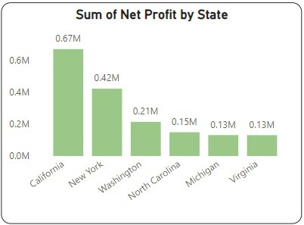
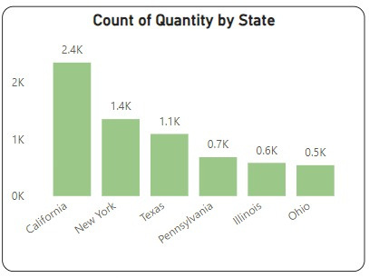
State wise Analysis
Washington has high net profit (0.21 million) but not in the top for quantity, indicating high-profit items or efficient operations.
Texas has higher quantity (1.1 thousand) but not in the top for net profit, suggesting lower profit margins or higher operational costs.
Similarly North-Carolina, Michigan and Virginia have higher profits compared to Penn State, Illinois, Ohio who have higher quantity sold.
Notes:
Focus on High-Profit States: Investing more in California and New York could yield significant returns due to their high profitability and sales volume.
Improve Margins in Texas and Other States: Efforts could be made to either reduce costs or increase prices in states like Texas to improve net profit. Higher quantity can be sold in states having higher profits to increase the overall net profit.

Slide 11
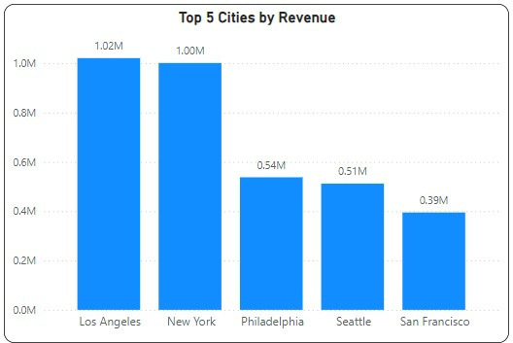
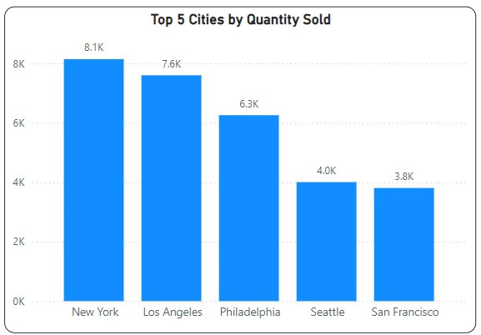
Los Angles and New York are the best performing cities, generating a total of 1M in revenue, respectively.
Notes:
Targeted Marketing: Implement localized marketing campaigns in Philly, Seattle and San Francisco and maintain targeted promotions in LA and NY to boost their sales.
Customer Engagement Partnerships:
Leverage digital marketing channels in tech-savvy cities like San Francisco and Seattle to increase engagement.
Ensure sufficient inventory and optimized logistics to meet high demand in top cities like New York(10.79) and Los Angeles(10.86), reducing delivery times for enhancing customer satisfaction.

Slide 12
Strategies to Increase Revenue and Profit
Diversification and Product Development: We should introduce products that cater to hybrid work mode as Home Office yields highest revenue of $6.6M in customer segment.
Customer Loyalty Programs: Staggering 92% of Net revenue is coming from Loyal customers we should enhance loyalty programs and incentivize repeat purchases.
Regional Focus: Strengthen presence in high-performing regions like the Southern and Midwest regions by increasing marketing efforts and local partnerships.
New Markets: Exploring untapped markets such as New England where we have the Highest AOV ($2214) and Lowest Products (5000) sold by implementing strategic advertising.

Slide 13
